Slide 1

Algoritma Pemrograman Dasar :
Javascript
5
Day 6

Slide 2
1
Function
Outline Class
2
Lodash

Slide 3
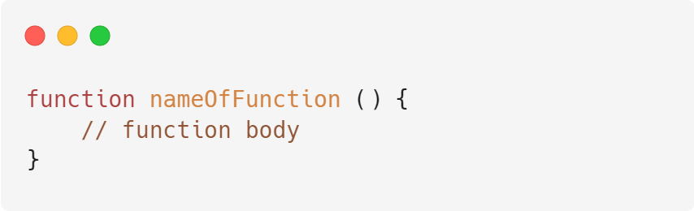
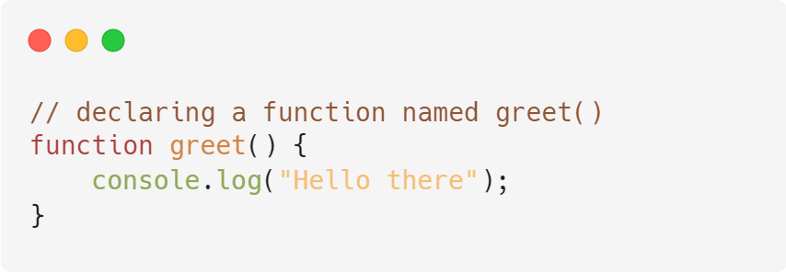
Functions
A function is a block of code that performs a specific task.
Suppose you need to create a program to create a circle and color it. You can create two functions to solve this problem:
a function to draw the circle
a function to color the circle
Dividing a complex problem into smaller chunks makes your program easy to understand and
reusable.

Slide 4
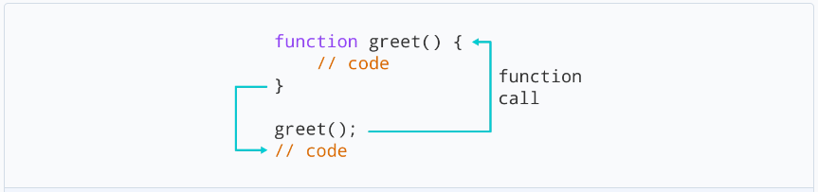
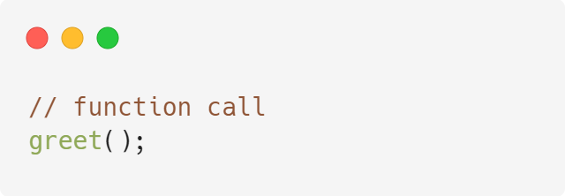
Calling a Function
In the above program, we have declared a function named greet(). To use that function, we need to call it.
Here's how you can call the above greet() function.

Slide 5
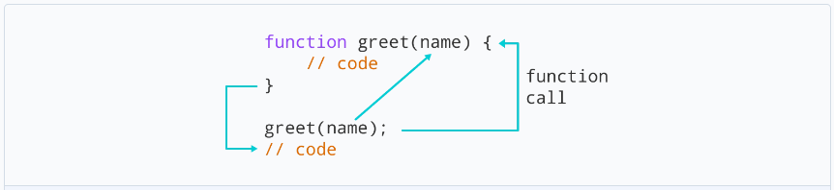
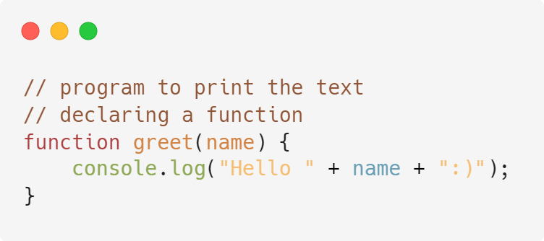
Function Parameters
A function can also be declared with parameters. A parameter is a value that is passed when declaring a function.

Slide 6
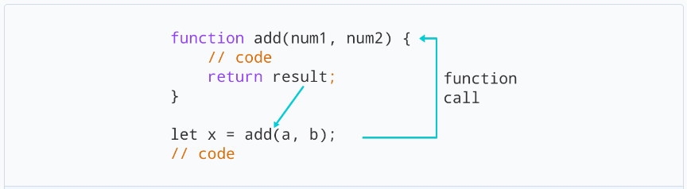
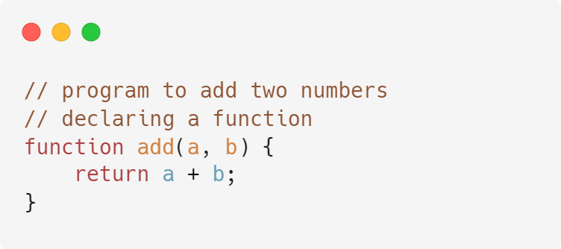
Function Return
The return statement can be used to return the value to a function call.
The return statement denotes that the function has ended. Any code after return is not executed.
If nothing is returned, the function returns an undefined value.

Slide 7
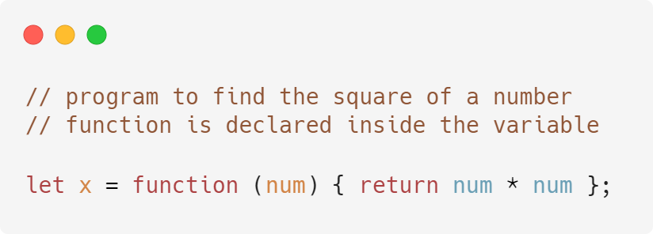
Function Expressions
In Javascript, functions can also be defined as expressions. For example,

Slide 8
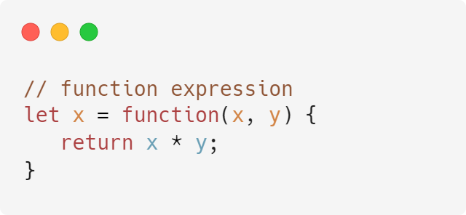
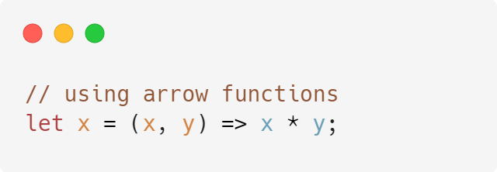
Arrow Function
Arrow function is one of the features introduced in the ES6 version of JavaScript.
It allows you to create functions in a cleaner way compared to regular functions.
For example,
This Function
can be written as
using an arrow function.

Slide 9
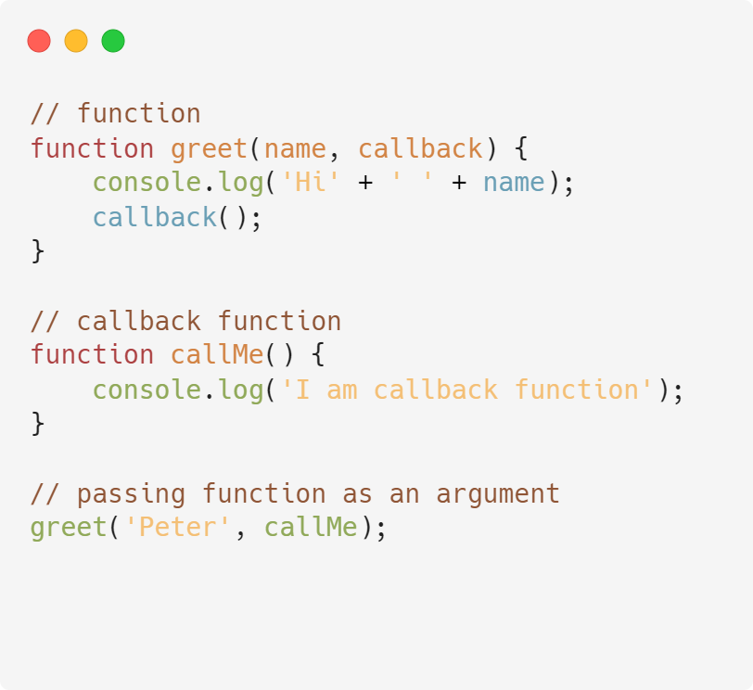
CallBack Function
In JavaScript, you can also pass a function as an argument to a function. This function that is passed as an argument inside of another function is called a callback function. For example,

Slide 10
Lodash
Lodash is a JavaScript library that provides utility functions for common programming tasks using a functional programming paradigm; it builds upon the older underscore.js library.
Lodash has several built-in utility functions that make coding in JavaScript easier and cleaner.

Slide 11
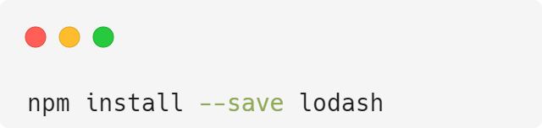
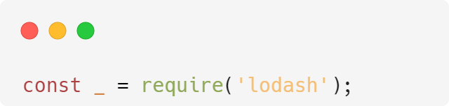
Installation Lodash
Lodash can be installed via NPM:
After installation is complete, Lodash can be imported into a JavaScript file as:

Slide 12
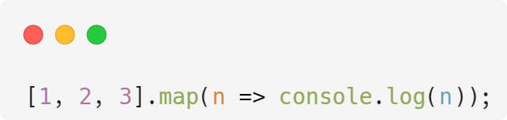
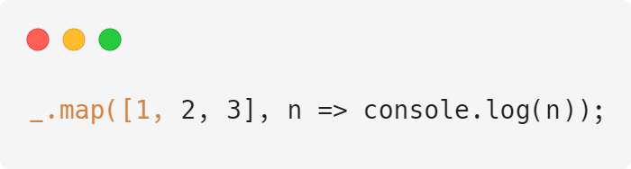
Lodash Iteration
ES6 map
lodash map
But Lodash’s _.map is more powerful, in that it works on objects, guards against null parameter, and has better performance.

Slide 13
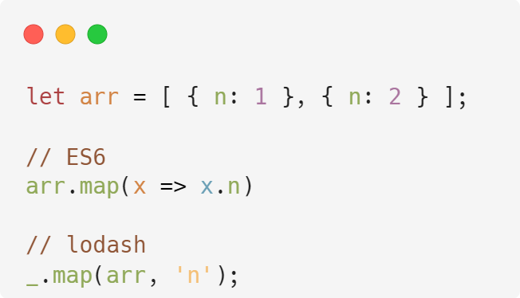
Lodash Map
To extract some property from an array of objects:

Slide 14
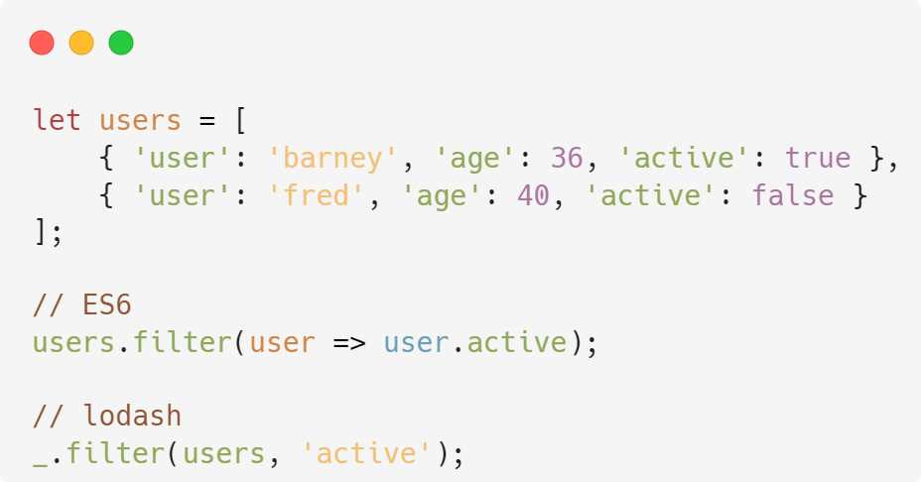
Lodash Filter
Filter from some property from an array of objects:

Slide 15
Thank you

